Slide 1
Chapter 2.9 Creating High-Quality Code
CCSW 325 (Software Construction)
Notes:
Last Update: 22/8/2019
Version 1.0

Slide 2
Outline
High Quality Routines (Part 3 of 3)
Design at the Routine Level

Slide 3
Design at the Routine Level
Cohesion
Coupling
how closely the operations in a routine are related
the relationships between functions

Slide 4
Design at the Routine Level: Cohesion
Some programmers prefer the term “strength”; how strongly related are the operations in a routine
Cosine()
A function like Cosine() is perfectly cohesive because the whole routine is dedicated to performing one function.
CosineAndTan()
A function like CosineAndTan() has lower cohesion because it tries to do more than one thing. The goal is to have each routine do one thing well and not do anything else.
One study of 450 routines found that 50 percent of the highly cohesive routines were fault free, whereas only 18 percent of routines with low cohesion were fault free (Card, Church, and Agresti1986)
Another study of a different 450 routines found that routines with the highest coupling-to-cohesion ratios had 7 times as many errors as those with the lowest coupling-to- cohesion ratios and were 20 times as costly to fix (Selby and Basili1991)

Slide 5
Design at the Routine Level: Desired Cohesion
Functional Cohesion
Functional cohesion is the strongest and best kind of cohesion, occurring when a routine performs one and only one operation
Compute Cosine of Angle
Verify Alphabetic Syntax
Read Transaction Record
Determine Customer Mortgage Repayment
Compute Point of Impact of Missile
Calculate Net Employee Salary
Assign Seat to Airline Customer

Slide 6
Design at the Routine Level: Acceptable Cohesion
Sequential Cohesion
Sequential cohesion exists when a routine contains operations that must be performed in a specific order, that share data from step to step, and that don’t make up a complete function when done together.
For example, given a birth date, calculates an employee’s age and time to retirement.
If the routine calculates the age and then uses that result to calculate the employee’s time to retirement, it has sequential cohesion.

Slide 7
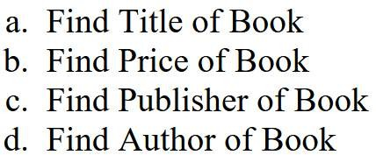
Design at the Routine Level: Acceptable Cohesion
Communicational Cohesion
Communicational cohesion occurs when operations in a routine make use of the same data and aren’t related in any other way.
For example, suppose you wrote a function to query a database to get the name and office number for an employee in your company.
It may make sense for your application, but the only common point between the two operations is that the data comes from the same employee record.

Slide 8
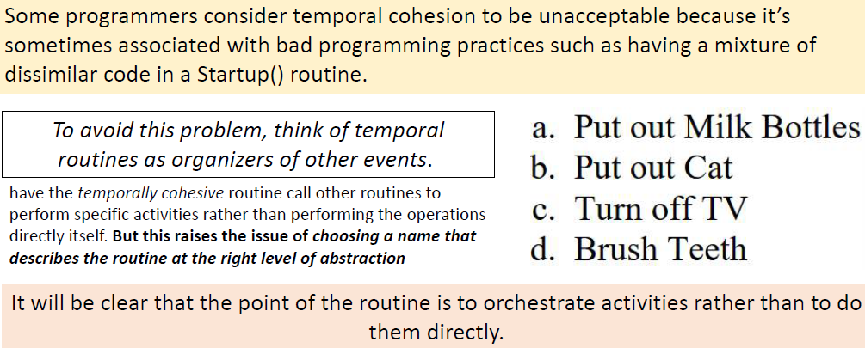
Design at the Routine Level: Unacceptable Cohesion
Temporal Cohesion
Temporal cohesion occurs when operations are combined into a routine because they are all done at the same time.

Slide 9
Design at the Routine Level: Unacceptable Cohesion
Procedural Cohesion
Procedural cohesion occurs when operations in a routine are done in a specified order.
The routine has procedural cohesion because it puts a set of operations in a specified order and the operations don’t need to be combined for any other reason.
Clean Utensils from Previous Meal
Prepare Chicken for Roasting
Make Phone Call
Take Shower
Chop Vegetables
Set Table
To achieve better cohesion, put the separate operations into their own routines.

Slide 10
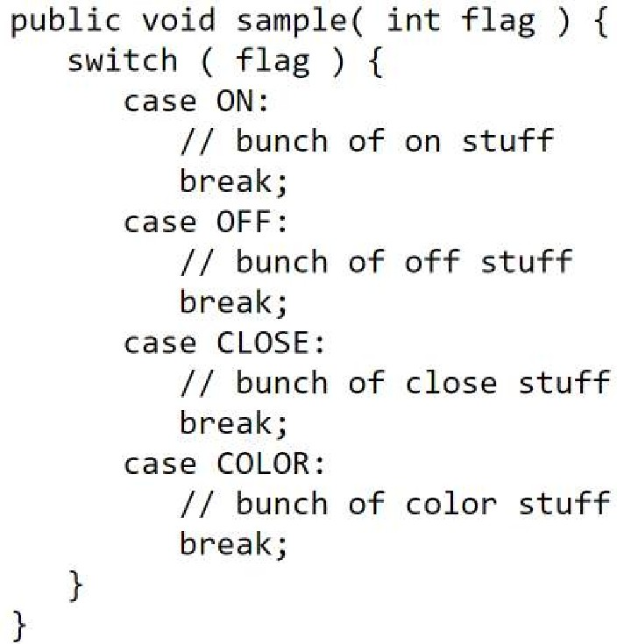
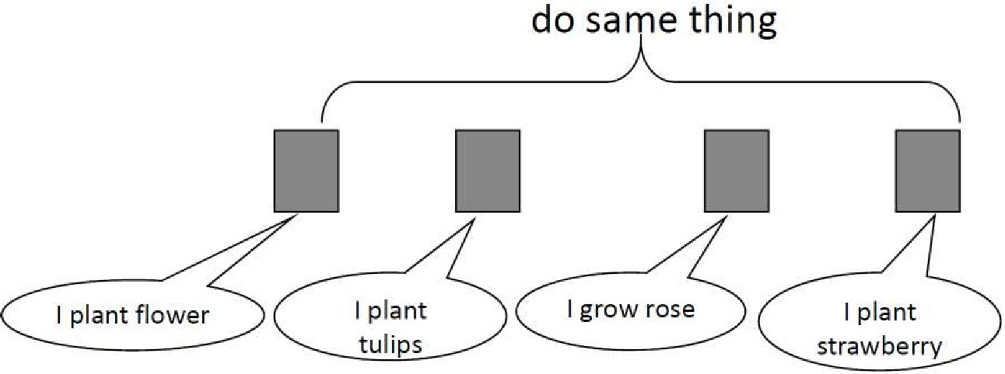
Design at the Routine Level: Unacceptable Cohesion
Logical Cohesion
Logical cohesion occurs when several operations are stuffed into the same routine and one of the operations is selected by a control flag that’s passed in.
The control flow or “logic” of the routine is the only thing that ties the operations together—they’re all in a big if statement or case statement together.

Slide 11
Design at the Routine Level
Design at the Routine Level: Bad Coupling
Tight Coupling
Large dependence on the structure of one module by another.
Design at the Routine Level: Good Coupling
Loose Coupling
Modules with loose coupling are more independent and easier to maintain
Design at the Routine Level: Worst Coupling
Content Coupling
A module changes another module’s data

Slide 12
Design at the Routine Level
Design at the Routine Level: Not Worst Coupling
Common Coupling
This occurs when all modules reference the same global data structure
Design at the Routine Level: Not Worst Coupling
External Coupling
Modules communicate through an external medium, such as files
Design at the Routine Level: Acceptable Coupling
Control Coupling
Two modules exhibit control coupling if one (``module A'') passes to the other (``module B'') a piece of information that is intended to control the internal logic of the other.
Notes:
Computer Module:
Generates a document to be printed.
Formats the document according to a specific printer protocol (e.g., PostScript).
Sends the formatted document to the printer via a specific communication interface (e.g., USB).
Printer Module:
Waits for data from the computer.
Recognizes and understands the specific printer protocol used by the computer.
Prints the document based on the received formatted data.
Thermostat Module (Module A):
Measures the current room temperature.
Determines if the room is too cold or too warm.
Sends a control signal to the Heater module based on the temperature reading.
Heater Module (Module B):
Receives the control signal from the Thermostat.
If the signal is TURN_ON, it activates the heater to warm the room.
If the signal is TURN_OFF, it deactivates the heater.
In this example, the Thermostat module (Module A) is control-coupled with the Heater module (Module B) because it sends a control signal that dictates the internal behavior of the Heater module. The Heater doesn't decide on its own whether to turn on or off; it relies on the control signal from the Thermostat.

Slide 13
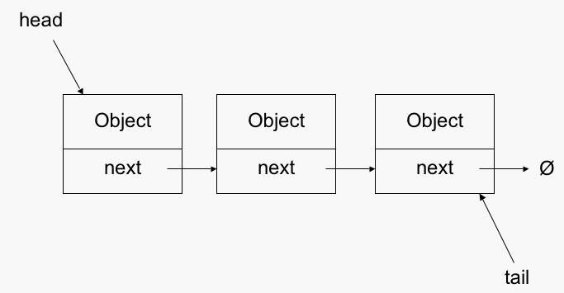
Design at the Routine Level: Acceptable Coupling
Stamp Coupling
Two modules (``A'' and ``B'') exhibit stamp coupling if one passes directly to the other a ``composite'' piece of data-that is, a piece of data with meaningful internal structure -such as a record (or structure), array, or (pointer to) a list or tree.
Notes:
In this example, both the Payroll and ContactDetails modules are stamp-coupled because they share the Employee data structure but use only specific parts of it.

Slide 14
Design at the Routine Level: Ideal Coupling
Modules A and B have the lowest possible level of coupling – no coupling at all - if they have no direct communication and are also not ``tied together'' by shared access to the same global data area or external device.
it implies that A and B be implemented, tested, and maintained (almost) completely independently; neither will affect the behavior of the other

Slide 15

Reading
Code Complete: A Practical Handbook of Software Construction, 2nd Edition, Steve McConnell.
Chapter 7

Slide 16

Any questions? ​
Please feel free to raise your hands and ask.

